Slide 1
TRIPLE TALK WMKT
The best News Talk lineup
in the North!

Slide 2
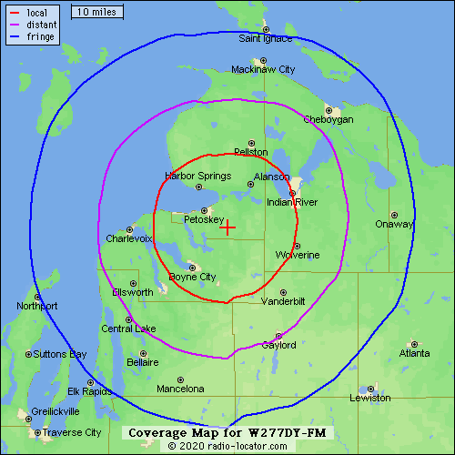
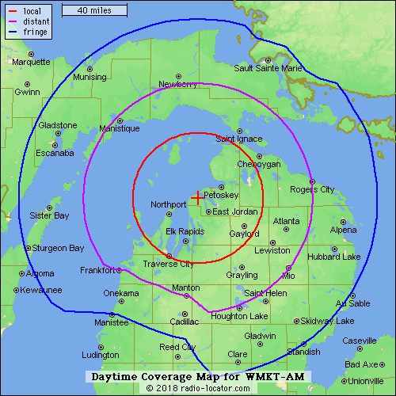
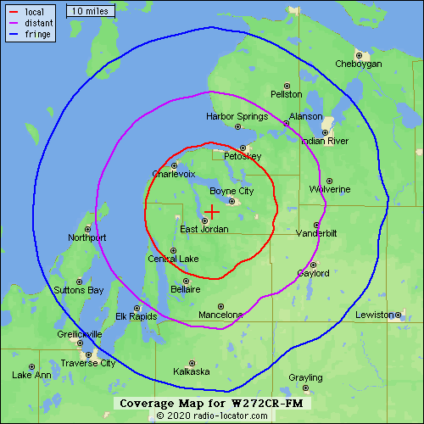
3 Signals for 3X the coverage
103.3 FM
1270 AM
102.3 FM

Slide 3
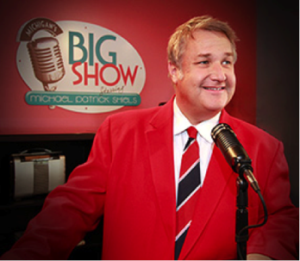
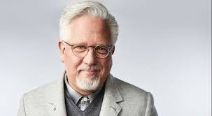
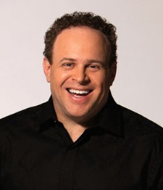
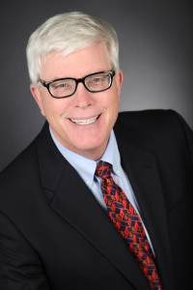
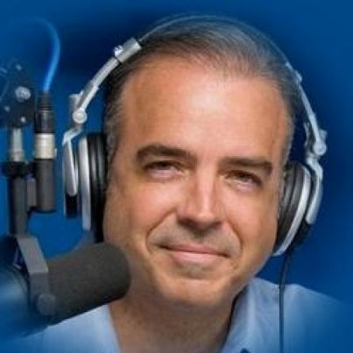
The WMKT Lineup
Glenn Beck
Noon-3pm
Michael Patrick Shiels
6-9am
Hugh Hewitt
Noon-3pm
…and more!
Todd Schnitt, 3-6pm
Joe Pags, 6-9pm

Slide 4
The WMKT Audience
Target Audience: Persons 35+
Format: News Talk
Specializes in reaching affluent consumers with discretionary income
WMKT Listeners Are:
130% more likely (than the avg person) to own $150K+ in stocks
112% more likely to have recently bought insurance
112% more likely to seek financial advice
108% more likely to have spent $300+ at restaurants past 6 mos
96% more likely to have used a home decorator

